Slide 1
Understanding Work With Data in Summer STEM Programs Through An Experience Sampling Method Approach
Joshua M. Rosenberg
Michigan State University
A Dissertation Defense
6/22/2018
Presented to:
Matthew J. Koehler (Co-chair), Jennifer A. Schmidt (Co-chair), Lisa Linnenbrink-Garcia, and Christina V. Schwarz
These slides and the manuscript: http://jmichaelrosenberg.com

Slide 2
Background and Purpose
Purpose: Examine youth engagement in work with data during outside-of-school (summer) STEM enrichment programs
Describe the nature of work with data in this context
Provide insight into relationships between work with data and youth characteristics and engagement
Notes:
Some research on using data to ask authentic questions and solve real problems (e.g., Hancock, Kaput, & Goldsmith, 1992) in mathematics
Some research in programming and computer science (Wilkerson-Jerde & Wilensky, 2015)
No research examining work with data through the lens of engagement (cf. Lee & Wilkerson, 2018)
Doing so can build on past research by showing how engaging particular strategies are
Can be used to study engagement in-context but also across activities and STEM content areas

Slide 3
Conceptualizing Work with Data
Asking questions
Making observations
Generating data
Data modeling
Interpreting and communicating findings
(Franklin et al. 2007; Lehrer & Schauble, 2004; Lee & Wikerson, 2018; Wild & Pfannkuch, 1999)

Slide 4
Work with data in outside-of-school STEM programs
Organizing set of activities or practices across STEM
Found in STEM curricular standards
Potentially valuable but not the emphasis of past programs

Slide 5
Defining Youth Engagement
Past research points out multiple dimensions of engagement influenced by specific conditions (Csikszentmihalyi, 1990; Fredericks, Blumenfeld, & Paris, 2004)
Learning something new (cognitive engagement)
Working hard (behavioral engagement)
Enjoying the activity (affective engagement)
How challenging the activity is (perceptions of challenge)
How good at the activity youth are (perceptions of competence)

Slide 6
Studying Engagement
Use of Experience Sampling Method, ESM (Hektner, Schmidt, & Csikszentmihalyi, 2007)
Profiles used to investigate how engagement is experienced together and at once (e.g., Bergman & Magnusson, 1997)
Youth characteristics and individual differences have impacts (e.g., Bystydzienski, Eisenhart, & Bruning, 2015; Hidi & Renninger, 2006; Shernoff & Schmidt, 2008)

Slide 7
Research Questions
What is the frequency and nature of opportunities for youth to engage in each of the five aspects of work with data in summer STEM programs?
What profiles of engagement emerge from data collected via ESM in the programs?
What are sources of variability for the profiles of engagement?
How do the five aspects of work with data relate to profiles of engagement?
How do youth characteristics (Relate to profiles of engagement?
Notes:
1. What is the frequency and nature of opportunities for youth to engage in each of the five aspects of work with data in summer STEM programs?
1. What are sources of variability for the profiles of engagement?
1. What profiles of engagement emerge from data collected via ESM in the programs?
1. How do the five aspects of work with data relate to profiles of engagement?
1. How do youth characteristics relate to profiles of engagement?

Slide 8
Context and Participants
Programs
Designed around best practices for out-of-school programs
In cities in the Northeast United States
Youth
203 youth
Racially and ethnically diverse

Slide 9
Procedure
Pre-survey
Pre-program interest in STEM, gender, and racial and ethnic group
ESM data
Collected two days each week, for three weeks (weeks 2-4 of the program)
Signals were at different times between programs and between days
Video-recordings of programs
Video segmented into instructional episodes, activities before ESM signal
Variables for work with data from STEM-PQA measure (Forum for Youth Investment, 2012)

Slide 10
RQ #1: Frequency and nature of work with data from analysis of video-recordings
1.86 aspects of work with data per instructional episode (SD = 1.61)
63.60% of episodes involved any of the aspects of work with data
36.40% of episodes involved none

Slide 11
Variation in terms of specificity of the activity
Variation in terms of being youth vs. instructor driven
Variation in terms of particular pedagogical approaches
Example: Asking questions
Youth actively constructing predictions and hypotheses about phenomena (39/90, or 43%)
Youth asking a more general type of question (21/90; 23%)
Instructor (but not youth) posing questions or identifying problems (14/90; 15%)
In other unsystematic ways (23/90; 25%)
Notes:
Among the instructional episodes that involved asking questions, qualitative descriptions revealed that around one-third (39/90, or 43%) involved youth working to understand the phenomenon or problem they were investigating. When doing so, youth were focused on actively constructing predictions and hypotheses about phenomena. For example, in an instructional episode during the *Ecosphere* program in which youth constructed inclined tables to study how water moved throughout the ecosystem, the youth activity leader prompted youth to generate hypotheses of what would happen when water was poured onto the table, before pouring the water.
Other instructional episodes involved questions that were not focused on predicting or hypothesizing, but instead on asking a more general type of question (21/90; 23%), or involved the *instructor* (but not youth) posing questions or identifying problems (14/90; 15%). In the former case, youth were found to be asking more general questions about understanding the assignment, task, or even the phenomena. For instance, in the *Marine Investigators* program, youth visited a water treatment site and were provided opportunities to ask questions about what they observed: However, youths' questions were not questions that could then be answered with empirical data, but were rather to clarify their understanding. In the latter, instructors were asking youth questions (i.e., questions to elicit youths' conceptual understanding). The remaining (23/90; 25%) episodes represented themes that were not very common or systematic.

Slide 12
RQ #2: Profiles of engagement using LPA
Notes:
Six profiles of engagement from youths’ ESM responses were identified
Challenge – below 1.5 on 1-4 scale
Full and eng. And comp – quite high (at or above 3.5 for all vars)

Slide 13
RQ #3: Sources of variability via ICCs

Slide 14
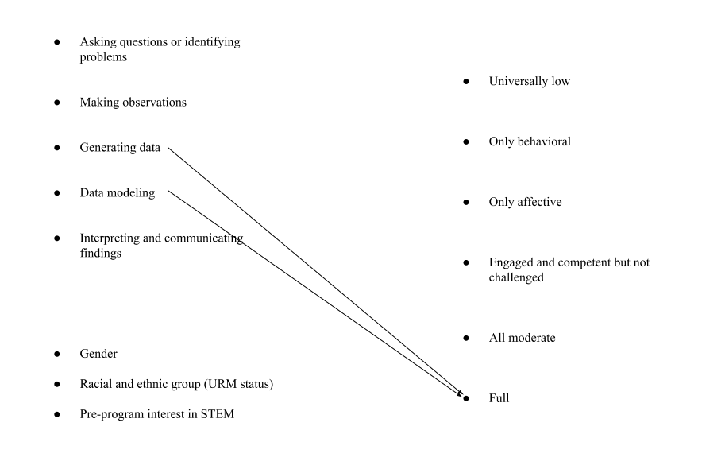
RQ #4: Relations with profiles of engagement via mixed effects models
0.03
0.03

Slide 15
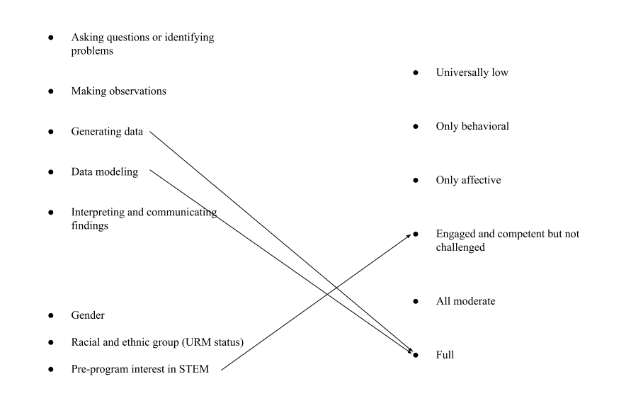
RQ #5: Relations with profiles of engagement via mixed effects models
0.03
0.03
0.04
Notes:
This follow-up analysis revealed that the effect of modeling data on *Full* engagement much more robust than that for generating data: 9.835% of this effect (of data modeling) would have to be due to bias to invalidate the inference about its effect. For generating data, only 1.884% of the effect of generating data would need to be due to bias to invalidate the inference about its effect. These values are not minuscule but are also not very large (Frank, 2003)
For this effect, 17.879% would be needed to invalidate the inference, a slightly larger value for the follow-up sensitivity analysis than those found for the (statistically significant) relations involving the aspects of work with data, suggesting a moderately robust effect.

Slide 16
Insights about work with data
Work with data occurred regularly
Frequently enough that we might expect to see differences in youths' engagement
New information about work with data that builds on past research
Baseline of engagement in specific aspects of work with data
Analytic approach has some potential for studying engagement in practices (across domains)
Work with data was highly varied in nature
As varied as in in science education (e.g., Berland & McNeil, 2017)
Somewhat aligned with descriptions in other domains (e.g., Dickes, Sengupta, Farris, & Basu, 2016; Hancock et al., 1992)

Slide 17
Engagement in out-of-school STEM programs
Same number of profiles as found in past research on profiles of engagement (e.g., Schmidt, Rosenberg, & Beymer, 2018)
Some profiles similar to those in past research
One was distinct: Engaged and competent but not challenged
Greater in number than in research on achievement goals (Wormington & Linnenbrink-Garcia, 2017)
Importance of including perceptions of challenge and competence
Notes:
First, they suggest that perceptions of challenge and competence be considered in future research.

Slide 18
Important relations with engagement
Generating data
Related to full engagement
Inscriptions serve commitments (Lehrer & Schauble, 2006)
Modeling data
Also related to full engagement
The central practice (Schwarz et al., 2009; Lehrer & Schauble, 2015; Weisberg, 2012)

Slide 19
Limitations and recommendations for research
Programs were not designed especially to support youth in work with data
Environments designed support work with data may support more sustained and sequenced work
May show different relations between work with data and engagement
Work with data can be difficult to measure
Measure designed to examine support for STEM skill-building
Difficulty of using observational measures of teacher practice (Mikeska et al., 2017), particularly for work with data (Jones, 2016)
Little variation in terms of profiles used to measure engagement
Consider other variables that make up engagement
Relations with each variable individually
Notes:
For example, for the interpreting and communicating findings code, the STEM-PQA codes for *Analyze* ("Staff support youth in analyzing data to draw conclusions ") and *Use symbols or models* ("Staff support youth in conveying STEM concepts through symbols, models, or other nonverbal language") were used. In the case of the latter STEM-PQA code, conveying STEM concepts through symbols, models, or other nonverbal language could have reflected instructional episodes in which youth used, for example, mathematical equations or formulas, but did not do so as part of modeling data of a phenomena in the world
As another example of this limitation related to how work with data was measured, generating data was an aspect of work with data that the open-ended qualitative analysis revealed to be less associated with less systematic groups of practices, or themes, than the other aspects. The STEM-PQA codes corresponding to this aspect of work with data were *Collect data or measure* ("Staff support youth in collecting data or measuring") and *Highlight precision and accuracy* ("Staff highlight value of precision and accuracy in measuring, observing, recording, or calculating "). Particularly in the case of the latter code, the emphasis on precision and accuracy may have been outside of activities focused on recording data or creating coding frames

Slide 20
Implications for practice
Generating data and modeling data in particular may be beneficial in terms of engaging youth
Youth activity leaders may emphasize these practices
Work with data (and even specific aspects of work with data) does not involve activities that are enacted in a universal way
Who works with data, how they do so, and how much time is required

Slide 21
Thank you! Acknowledgments and dedication
Matthew Koehler, Jennifer Schmidt, Linnenbrink-Garcia, and Christina Schwarz
Thank you to my other mentors in the EPET program (particularly Leigh Graves Wolf) and to my peers in the program and at MSU
Thank you to collaborators Lee Shumow and Neil Naftzger for their work on the STEM Interest and Engagement project (National Science Foundation DRL-1421198)
Thank you to participating youth activity leaders and youth
This dissertation is dedicated to Katie and to Jonah and to my family

Slide 22
ADDITIONAL SLIDES

Slide 23
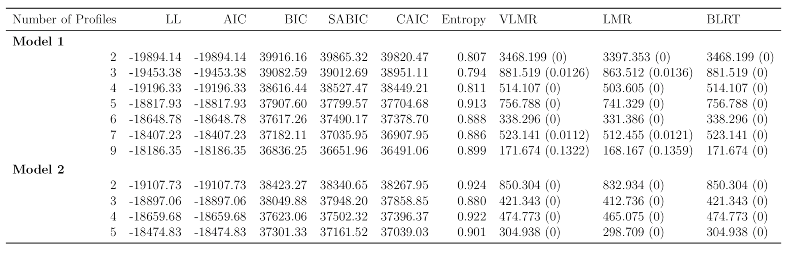

Slide 25
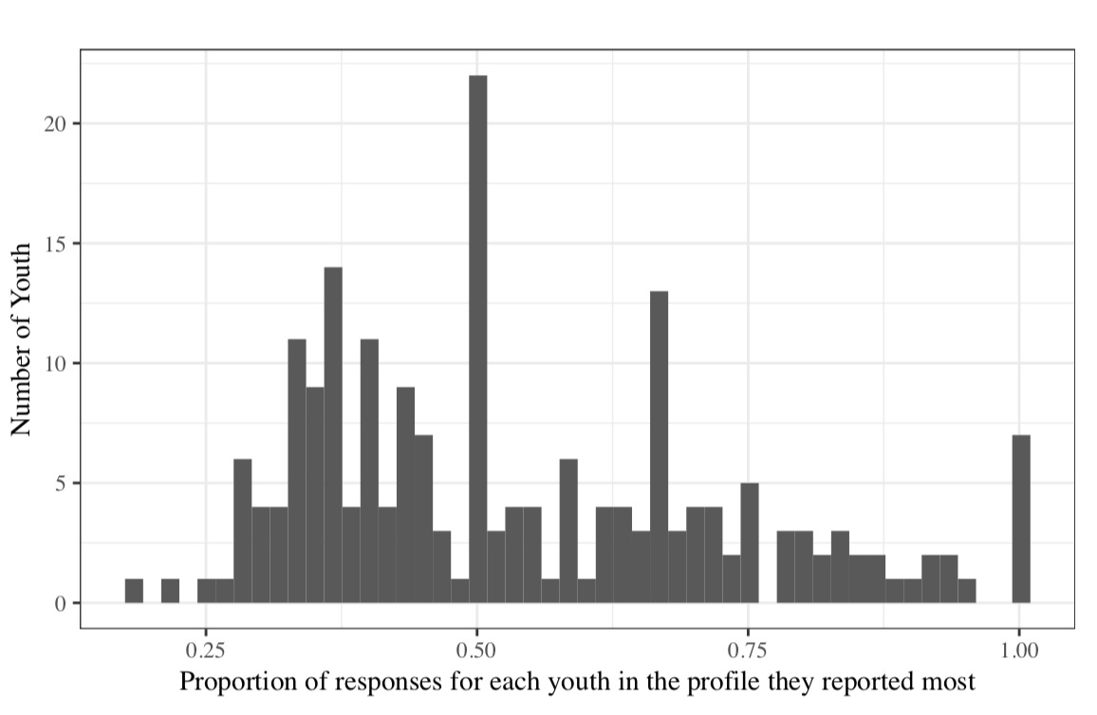

Slide 26
